Slide 1
Logistic Regression
Mr. Shrikrishna Anand Narvekar
Assitant Professor
Computer Engineering department
Agnel Institute of Technology and Design

Slide 2
Content
Introduction
Problem statement
Logistic regression Use Cases

Slide 3
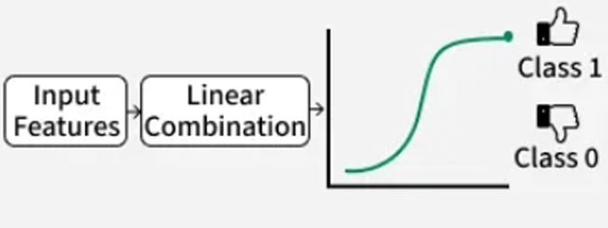
Introduction
Logistic regression is used when the target (dependent) variable is binary or categorical, like obese (1) and non-obese (0).
Instead of predicting the exact value, logistic regression predicts the probability of an event (e.g., being obese).
It uses sigmoid function to map input to probabilities

Slide 4
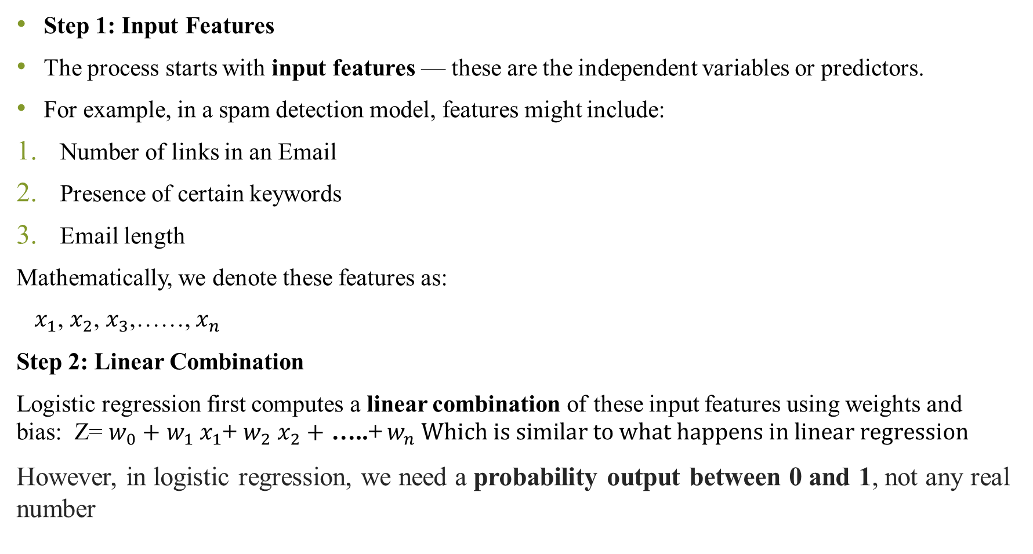
Step 1: Input Features
The process starts with input features — these are the independent variables or predictors.
For example, in a spam detection model, features might include:
Number of links in an Email
Presence of certain keywords
Email length
Mathematically, we denote these features as:
$x_{1}$, $x_{2}$, $x_{3}$,……, $x_{n }$
Step 2: Linear Combination
Logistic regression first computes a linear combination of these input features using weights and bias: Z= $w_{0}+$ $w_{1}$ $x_{1}$+ $w_{2}$ $x_{2}+$ …..+ $w_{n} Which is similar to what happens in linear regression$
However, in logistic regression, we need a probability output between 0 and 1, not any real number

Slide 5
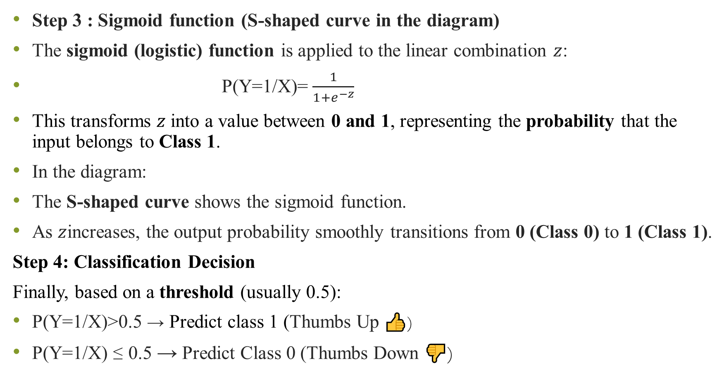
Step 3 : Sigmoid function (S-shaped curve in the diagram)
The sigmoid (logistic) function is applied to the linear combination $z$:
P(Y=1/X)= $\frac{1}{1+e^{−z}}$
This transforms $z$ into a value between 0 and 1, representing the probability that the input belongs to Class 1.
In the diagram:
The S-shaped curve shows the sigmoid function.
As $z$increases, the output probability smoothly transitions from 0 (Class 0) to 1 (Class 1).
Step 4: Classification Decision
Finally, based on a threshold (usually 0.5):
P(Y=1/X)>0.5 → Predict class 1 (Thumbs Up 👍)
P(Y=1/X) ≤ 0.5 → Predict Class 0 (Thumbs Down 👎)

Slide 6
Problem Statement
A health researcher wants to predict whether an individual is obese or not based on their body weight. The goal is to create a simple model that can classify a person as “Obese” (Class 1) or “Non-Obese” (Class 0) using weight as the input variable.
The researcher collects data from 100 individuals, recording their weight (in kg) and obesity status (1 = obese, 0 = non-obese). Using this data, the researcher applies logistic regression to understand how weight influences the probability of obesity.

Slide 7
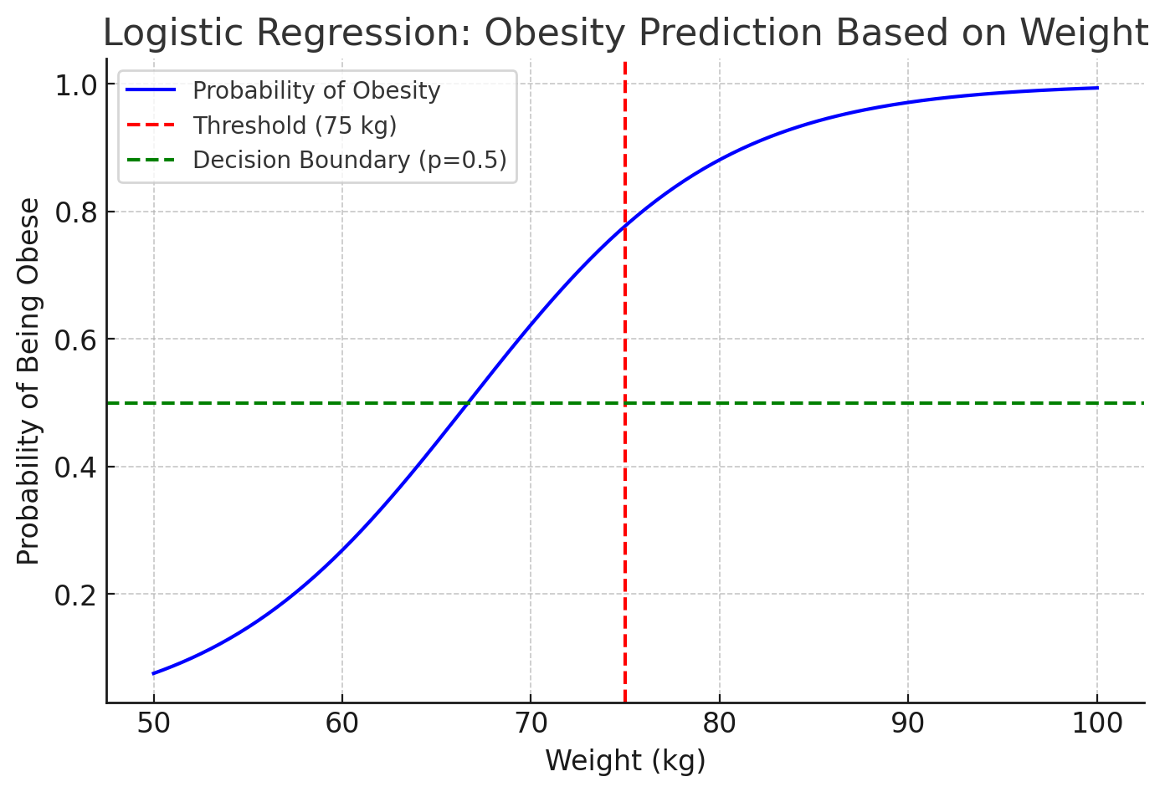
Graph Explanation:
X-axis (Weight): Represents the weight of individuals ranging from 50 to 100 kg.
Y-axis (Probability): Represents the probability of being obese. Values range from 0 (non-obese) to 1 (obese).
Sigmoid Curve (Blue Line): This is the logistic curve that models the relationship between weight and obesity. As the weight increases, the probability of being obese also increases, following an S-shape.
Red Vertical Line (Threshold at 75 kg): This line indicates the threshold where weight greater than 75 kg results in a probability above 0.5, classifying a person as obese.
Green Horizontal Line (Decision Boundary at 0.5): This line marks the cutoff probability of 0.5. If the probability is greater than 0.5, the individual is classified as obese. Below 0.5, the individual is classified as non-obese.

Slide 8
Logistic Regression Use cases
Medical :Probability of Patient’s successful response to specific medical treatment- Input could be age, weight etc.
Finance: Probability on applicant defaults on loan.
Marketing: Probability a wireless customer switches a carriers(churns).
Engineering: Probability a mechanical part malfunctions or fails.
Notes:
1. Medical Domain: Predicting Treatment Success
Use Case:
Predicting the probability of a patient’s successful response to a specific medical treatment.
Input Features:
Age of patient
Weight
Blood pressure
Cholesterol level
Dosage of medication
Output:
1 → Successful treatment
0 → Unsuccessful treatment
Example Interpretation:
If the model predicts a probability of 0.85, it means there’s an 85% chance that the patient will respond positively to the treatment.
2. Finance Domain: Loan Default Prediction
Use Case:
Estimating the probability that a loan applicant will default on repayment.
Input Features:
Applicant’s income
Loan amount
Credit score
Employment history
Number of existing loans
Output:
1 → Applicant will default
0 → Applicant will not default
Example Interpretation:
If the predicted probability is 0.7, the bank may decide to reject or review the loan application since there’s a 70% chance of default.
3. Marketing Domain: Customer Churn Prediction
Use Case:
Predicting the probability that a wireless customer will switch to another carrier (churn).
Input Features:
Monthly charges
Contract type (prepaid/postpaid)
Customer service calls
Tenure (how long they’ve been a customer)
Internet usage
Output:
1 → Customer likely to churn
0 → Customer likely to stay
Example Interpretation:
A probability of 0.6 means the customer has a 60% chance of leaving, prompting the company to offer retention benefits.
4. Engineering Domain: Predicting Part Failure
Use Case:
Determining the probability that a mechanical part will malfunction or fail under certain conditions.
Input Features:
Operating temperature
Pressure
Usage time
Material quality
Load capacity
Output:
1 → Part will fail
0 → Part will not fail
Example Interpretation:
If a part shows a 0.9 probability of failure, it signals engineers to replace or inspect the part before usage.

Slide 9
Examining likelihood of event
Binary health outcomes:
  The outcome is dichotomous, i.e., it has two possible outcomes:
    Depressed = 1 (Yes): The individual is diagnosed with depression.
    Depressed = 0 (No): The individual is not diagnosed with depression.
  Logistic regression predicts the likelihood of being in one of these two categories, with values ranging between 0 and 1.

Slide 10
Likelihood Comparison:
  Logistic regression allows for the comparison of likelihood between different groups:
    Case vs. Controls: For instance, the probability of depression in patients (case) versus healthy individuals (controls).
    Males vs. Females: The model can compare the likelihood of depression between genders.
    Chemo vs. No Chemo: It could be used to compare the likelihood of survival or response to treatment between patients undergoing chemotherapy versus those who do not.

Slide 11
What logistic regression predicts
Logistic regression is a statistical method used to predict the probability of an event happening (like an outcome with only two possibilities: yes or no, success or failure).
Predicting outcomes: Logistic regression helps us predict whether something will happen or not, based on known factors (independent variables). For example, we might predict whether a person is likely to be diagnosed with a disease (yes or no) based on factors like age, weight, and exercise habits.

Slide 12
Transforming data:
  In logistic regression, the outcome (yes or no) is transformed into something called the log of the odds (this is also known as the "logit").
  The odds represent how likely something is to happen compared to not happening.
  For example, if a doctor says that the odds of getting the disease are 3 to 1, this means it's 3 times more likely to get the disease than not.
Probabilities and odd
  In the real world, probabilities range between 0 and 1. For example, if there is a 70% chance of rain tomorrow, the probability is 0.7.
  Logistic regression transforms these probabilities into odds ratios, which can range from 0 to infinity.
  An odds ratio tells you how much more likely something is to happen compared to it not happening. For example, an odds ratio of 2 means something is twice as likely to occur.

Slide 13
Cut-off Point:
  Logistic regression uses a cut-off point to make a prediction. Typically, the cut-off is set at 0.5 (or 50%). If the predicted probability of the event happening is greater than 0.5, we predict that the event will happen. If it’s less than 0.5, we predict the event won’t happen.
  For example, if a model predicts a 70% chance of rain tomorrow, we would predict that it will rain. If it predicts a 30% chance, we would predict it won’t rain.

Slide 14


Odds Ratio
Odds Ratio is a key concept in logistic regression. It is defined as the ratio of the probability of an event occurring to the probability of the event not occurring. For instance, the odds of a person buying a product might be 3 to 1, meaning they are three times more likely to buy the product than not to buy it.
Formula for Odds:
Where P(Event) is the probability of the event happening.
Example: If the probability of buying a product is 0.75, then the odds are:
Notes:
This means the odds of buying the product are 3 to 1 (3 times more likely to buy than not buy).

Slide 15
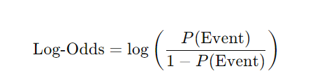
Logarithms of Odd
Logistic regression estimates the logarithm of the odds (also known as the log-odds or logit function). Instead of working with probabilities directly, logistic regression models the log of the odds because it converts the nonlinear relationship into a linear form that can be easily worked with.
Why Use Logarithms?
Probabilities are bound between 0 and 1, but odds can range from 0 to infinity. By taking the logarithm of the odds, we can map the entire range of odds to a scale that ranges from negative infinity to positive infinity, making it easier to model.

Slide 16
Maximum Likelihood estimation
Logistic regression uses a technique called Maximum Likelihood Estimation (MLE) to estimate the best-fitting model for the data.
MLE finds the set of coefficients (the weights on the independent variables) that maximize the likelihood of observing the data given the model.
MLE adjusts the model parameters so that the predicted probabilities match the actual outcomes as closely as possible.
Essentially, it chooses the values for the coefficients that make the observed data most likely.
Notes:
imple Example: Predicting Exam Pass or Fail
Let’s say we’re trying to predict whether a student passes (1) or fails (0) an exam based on the number of hours studied.
StudentHours Studied (X)Passed (Y)110220330451561681
Step 1: The Logistic Regression Model
The model predicts the probability of passing (Y=1) using the sigmoid function:
$$P\left(Y=1∣X\right)=\frac{1}{1+e^{−\left(b_{0}+b_{1}X\right)}}$$
Here,
$b_{0}$= intercept
$b_{1}$= weight (effect of study hours on passing)
We need to find $b_{0}$and $b_{1}$— and this is where MLE comes in.
Step 2: What MLE Does
MLE tries different values of $b_{0}$and $b_{1}$to see which combination makes the actual data (the 0s and 1s) most likely to occur.
For example:
Suppose with one set of values $b_{0}=−5,b_{1}=1$, the model predicts:
For 1 hour → $P\left(\text{pass}\right)=0.01$
For 8 hours → $P\left(\text{pass}\right)=0.99$
These predictions match the actual results well — low probabilities for students who failed, high for those who passed.
Thus, this combination of $b_{0}$and $b_{1}$gives a high likelihood of observing the data we actually have.
Step 3: The Likelihood Function
The likelihood is the product of probabilities for all observations:
$$L=\prod_{i=1}^{n}{P_{i}^{Y_{i}}}\left(1−P_{i}{\left.)\right.}^{\left(1−Y_{i}\right)}\right.$$
If a student passed ($Y_{i}=1$), we include $P_{i}$
If a student failed ($Y_{i}=0$), we include $1−P_{i}$
MLE chooses $b_{0}$and $b_{1}$that maximize this likelihood — i.e., make the actual outcomes (0s and 1s) as probable as possible.
Step 4: Intuitive Understanding
Think of MLE like tuning a probability curve to hug your data points closely:
If you guess poor coefficients, predicted probabilities don’t match actual 0s and 1s → low likelihood
If you guess the right coefficients, predictions align with reality → high likelihood
The computer uses optimization (like gradient ascent) to find this best fit.

Slide 17
Odd Ratio
The odds ratio provides a way to measure the strength of the relationship between the predictor (independent) variables and the outcome (dependent variable).
Odds Ratio Definition: It is the ratio of the odds of an event occurring in one group compared to another group.
Example:
Suppose you are comparing two groups—people who received a particular treatment (Group 1) and people who did not (Group 2). If the odds ratio is 2, it means that people in Group 1 are twice as likely to experience the event (e.g., recovery) as people in Group 2.

Slide 18
Estimating the Magnitude of Relationships:
The odds ratio helps estimate how much the independent variables (predictors) affect the likelihood of the event occurring. It tells us:
How much more or less likely one outcome is compared to another.
If the odds ratio is greater than 1, it suggests that the event is more likely to occur when the predictor variable increases.
If the odds ratio is less than 1, it suggests that the event is less likely to occur when the predictor increases.
Example: If you're studying the effect of exercise on heart disease, and the odds ratio is 0.5, it means that people who exercise are half as likely to develop heart disease compared to those who don’t.

Slide 19

Logistic Regression Model Description
Logistic regression is based on logistic function. It is a type of sigmoid function, which is S-shaped and maps any real number y to a value between 0 and 1.
The function is widely used in logistic regression to model probabilities, where the output f(y) represents the probability of an event occurring. The input y is usually a linear combination of the predictors (features).
For very large negative values of y, f(y) approaches 0.
For very large positive values of y, f(y) approaches 1.

Slide 20
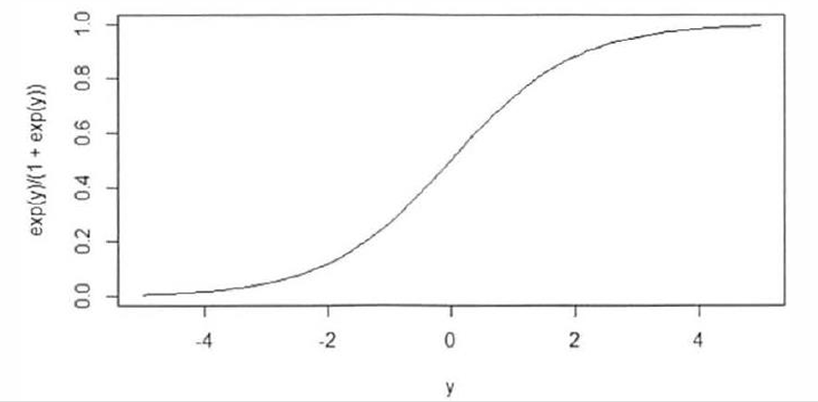

Graph of logistic function
The image shows the graph of the logistic function $\frac{e^{y}}{1+e^{y}}$ as a function of y
The x-axis represents the values of y.
The y-axis shows the output of the logistic function, ranging from 0 to 1.
Notes:
When y=0, f(y)= $\frac{e^{0}}{1+e^{0}}$ =0.5. this is where curve crosses the midpoint
As y becomes very negative, the function approaches 0, and as y becomes very positive, it approaches 1, creating the characteristic "S" shape.

Slide 21
Linear Regression vs Logistic regression
Linear Regression | Logistic Regression
Linear regression is used to predict continuous dependent variable using given set of independent variable | Logistic regression is used to predict categorical dependent variable using given set of independent variable
It is used for solving regression problem | It is used for classification problem
Here, we find best fit line | Here, we find best fit curve
It requires linear relationship between dependent and independent variable | It does not require linear relationship
There may be collinearity between the independent variable | There should be little or no collinearity between independent variable

Slide 22
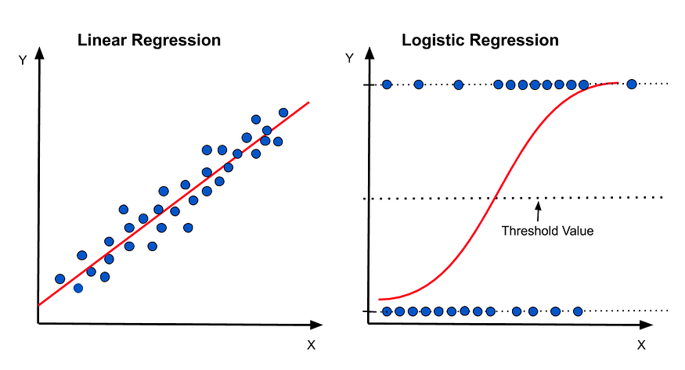
Why logistic regression is called regression if it is a classification algorithm

Slide 23
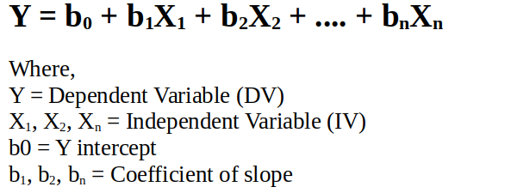
The Formula:
In linear regression, we predict the output variable Y base on the weighted sum of input variables.
The formula is as follows:

Slide 24
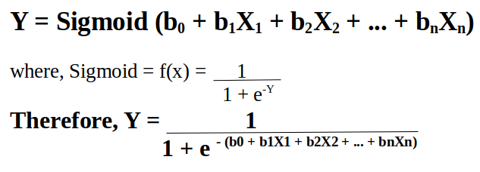
In logistic regression, we perform the exact same thing but with one small addition. We pass the result through a special function known as the Sigmoid Function to predict the output Y.
Linear regression gives a continuous value of output y for a given input X. Whereas, logistic regression gives a continuous value of P(Y=1) for a given input X, which is later converted to Y=0 or Y=1 based on a threshold value.
That’s the reason, logistic regression has “Regression” in its name.

